Slide 1
electronics system for a thrust stand name : savisree
Name : savisree
221004035
Objective:
Design an electronics system for a thrust stand to measure parameters such as current, voltage,
RPM, temperature, and thrust data for a brushless motor. Use an ESP32 MCU for control and data
logging. The power supply should be connected through a battery ranging from 4S to 6S LiPo battery.
The signal interface through the MCU should be there in ESC.

Slide 2
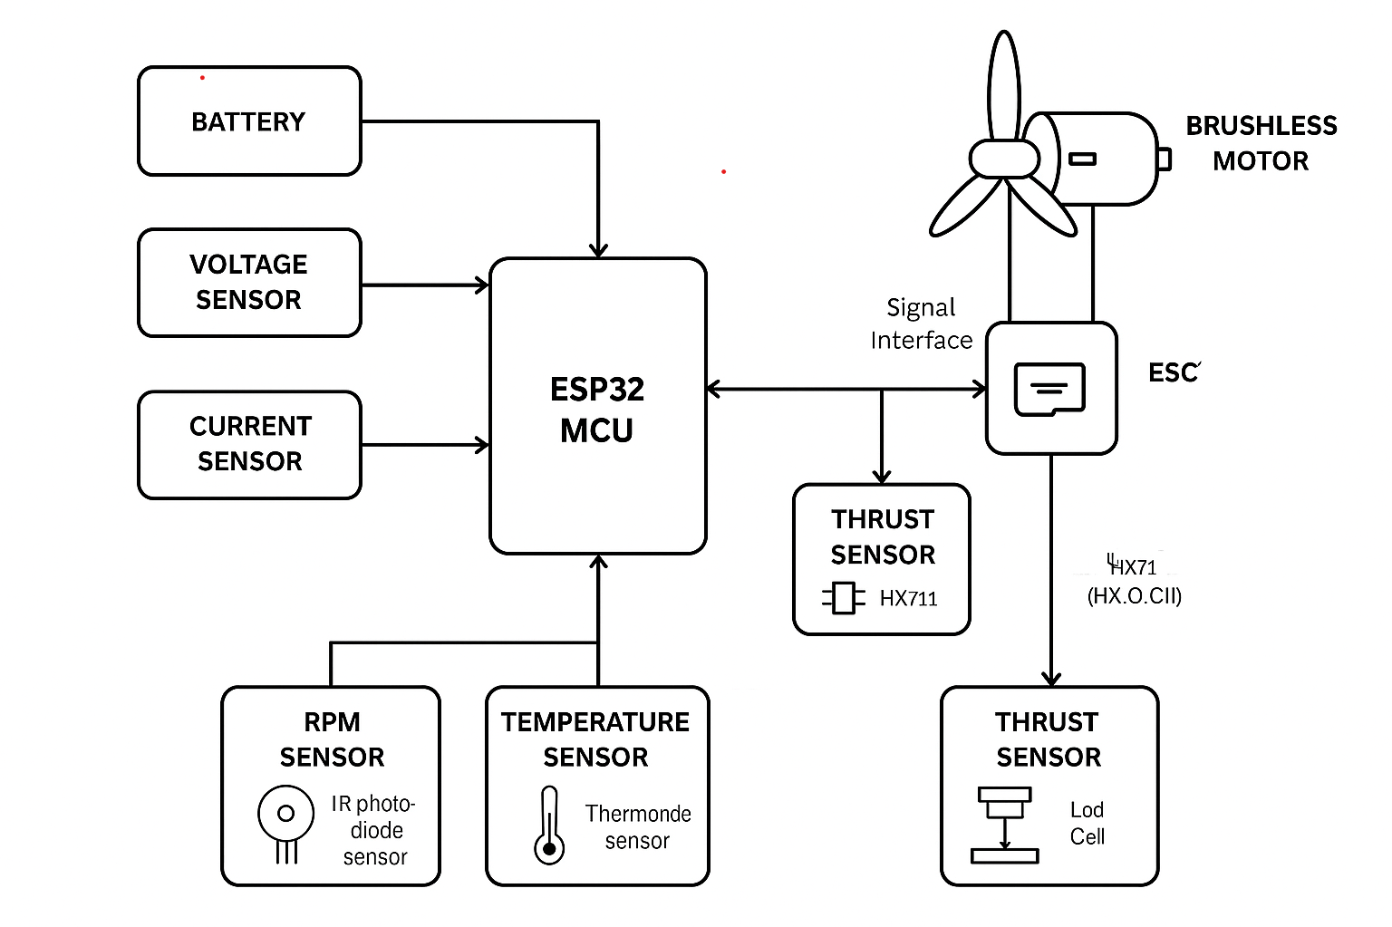
Architecture/Block Diagram:

Slide 3
Schematic design Requirements: 1. Battery Voltage: Up to 60V 2. Current Rating: Up to 60A 3. Thrust Data: Up to 5 KG (HX711 pressure sensor with Load Cell) 4. RPM Range Capability: Up to 100,000 RPM (IR photo diode sensor) 5. Current Sensor: Must support up to 60A (ACS 712 module) 6. Temperature Sensor: Up to 150 °C Schematic Design: o Develop a schematic design illustrating the interconnections between the ESP32 MCU and the various sensors and components. o Ensure all connections are clear and labelled appropriately. o Submit the schematic in PDF version.

Slide 4
